Slide 1

Atlantis Project Aquabot
Gigi Lucena, Gage Aschenbrenner, Daniel Cardenas, Brandon Umansky

Slide 2
Vision : The ROV (Remotely Operated Vehicle) should be able to navigate autonomously when predetermined waypoints are given. Having an unmanned ROV can cut the costs of using and maintaining it. The system can be useful to companies researching and exploring new and undiscovered underwater areas. It may also carry to on-land exploration. There may be times when it is not feasible for a human person to directly man or direct the ROV .
Roadmap:
1st Semester
Mission Control Module to initiate missions
Motion Control Module to translate missions into instructions
Camera Control system to initiate recording during missions
Simulated environment to represent the ROV in a body of water
2nd Semester
Modify system to work with ROV to replace the simulation
Obstacle avoidance
Development Methodologies
Requirements:
Use Cases
Design:
UML (Unified Modeling Language)
Implementation:
Languages: Python, C#, C
Verification / Validation:
Test Cases
Unit Testing
Integration Testing
Review
Walkthrough
Tools: Unity; ROS (Robot Operating System); VirtualBox VM (Virtual Machine); Ubuntu (Linux)
Libraries: LCM (Lightweight Communication and Marshalling); ROS
Atom (text editor)
PyCharm (IDE for python)
Draw.io (UML drawing)
Word (Use Cases)

Slide 3

ACHIEVEMENTS TO DATE
Project Level Burndown, Velocity, SLOCs Produced, Risks Realized and Mitigated,

Slide 4
Project Level Burndown

Slide 5
Project Velocity

Slide 6
SLOCs Produced
Planned Estimated
Actual
Module: | SLOC
Mission Control | 500 - 1000
Simulation | 1000 - 2000
Camera and Light Control | 500 - 1000
Route Planner | 500 - 1000
Navigator | 500 - 1000
Drift Correction | 500 - 1000
UI | 1000 - 1500
Total | 4500 - 8500

Slide 7






Risks Realized and Mitigated
Virtual Machine issues: Operating system errors in Ubuntu for one or more team members along with instance of loss of data
Mitigation: Coordinated VM, OS, and Software versions. Implemented updates to Github (pushes) more frequently
Computer Hardware limitations: Laptops lack the power and performance to run both UI and Simulation simultaneously
Mitigation: Immediately close UI following mission creation
ROV features unavailable: unable to oabtain sonar or mapping addons to the ROV
Mitigation: plan to simulate sonar via software by anticipating inputs and programming route planning and drift correction accordingly
Team member/s unvailable: team members have periodically missed meetings due to unforeseen circumstances
Mitigation: WhatsApp and Github allowed for away communication and transferring of data or information when necessary
Issues with Unity and LCM: encountered issues generating LCM messages in C#
Mitigation: Dedicated more team members and task hours to this issue
School interfered with sprint progress: sprint velocity suffered during certain periods of the semester, often coinciding with Exams or other Projects
Mitigation: Unfinished tasks were carried to next sprint and task loads were assigned appropriately

Slide 8
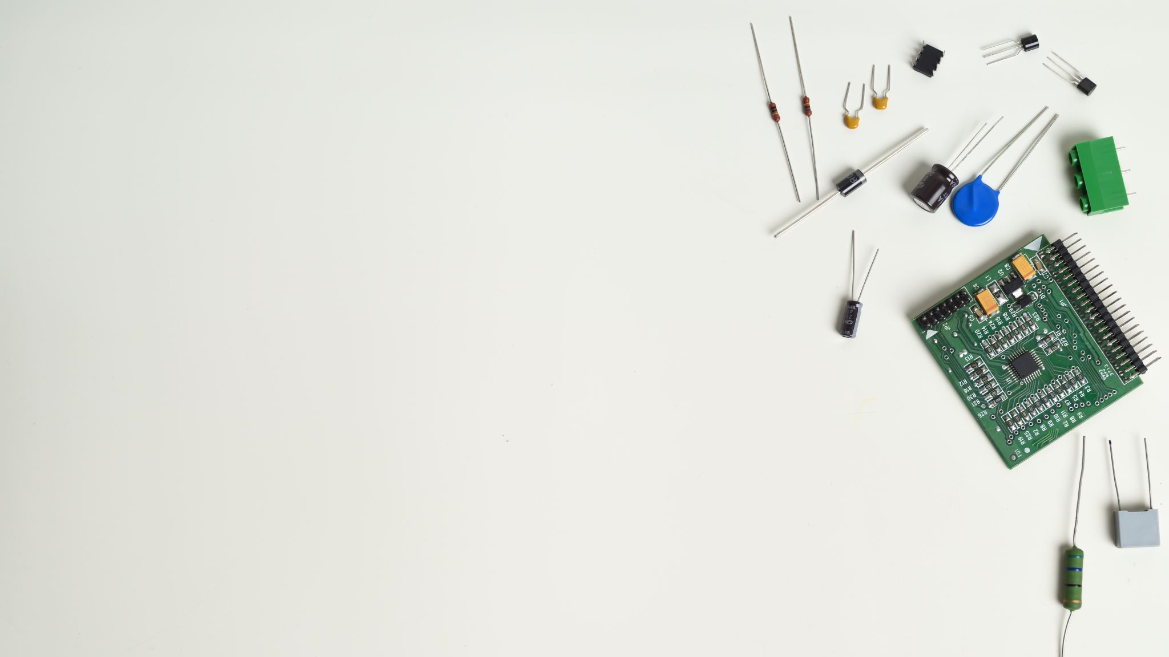
ENGINEERING WORK PRODUCTS
High Level Design, Product Backlog, Risks, Code, Diagrams, Schedule

Slide 9

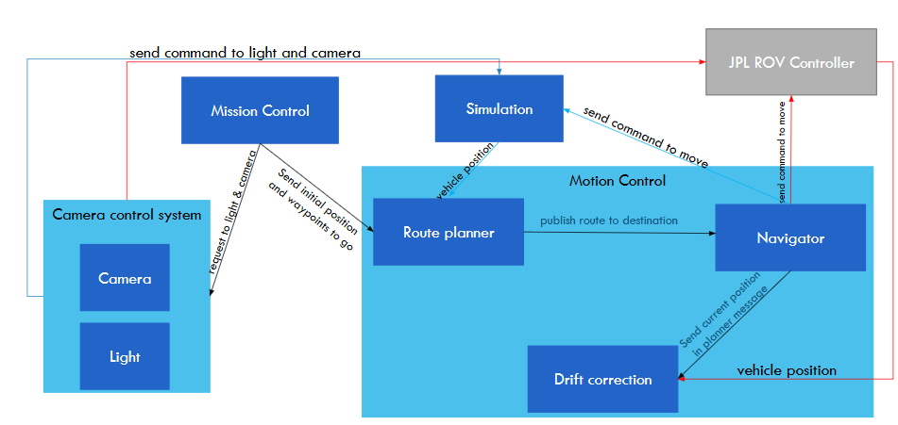
HIGH LEVEL DESIGN

Slide 10
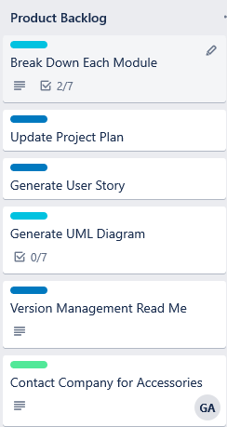
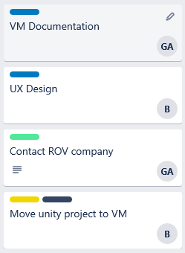
PRODUCT BACKLOG

Slide 11
Projected Risks
# | Date | Description | Probability | Severity | Planning/Mitigation Methods | Status/Date
1 | 9/16/19 | Tools used (ROS, LCM, Ubuntu/Linux) are new to some members. Each member will familiarize themselves with these tools. Time spent doing this is undetermined and may be more than planned. | High | High | Each member installs their own VM with the same version of Ubuntu. Each team member instructed to learn tools on their own. Online resources will be sought. Team members will tutor each other when able. | 9/18/2019 – Ubuntu version distributed and VM instructed
2 | 9/16/19 | Coordination of VirtualBox and Ubuntu installation requires that every member have same version. Each member may have their own hardware and installation issues which may delay development, since this is completed only when all members are completed. | Low | Medium | Application versions are kept up to date and used versions made clear. Team members may help with installation if necessary. | 9/23/2019 – Issues with VM and Ubuntu installation occurred. Members will install up-to-date versions from online sources.
3 | 9/18/19 | Unforeseen circumstances may prevent one or more team members from being able to attend one or more lab classes. | Medium | Low | Out of school communication systems (such as WhatsApp, Slack, GitHub) will allow communication and planning to continue even when a member is not physically present. File transfers and voice communications will provide pathways for retrieving and providing information and/or data. | 9/19/19 - WhatsApp, Slack, GitHub, and Trello registered for all members. Implementation of communication apps have been successful so far.
4 | 9/11/19 | Potential high cost of software tools and ROV use may hinder development and testing. | Medium | Low | Acceptable, free and open source software will be utilized. Attempts to simulate ROV movement and logic will provide a more cost-effective method of testing, rather than physical test cases. | 9/16/19 - ROS, GitHub, Ubuntu 18.04.3 LTS, Unity, and Online tutorials/manuals are being utilized at no cost.
5 | 9/23/19 | Due to the project not being a full-time job for any member, other school/work responsibilities may lead to a loss of time for working on the project. Inconsistent schedules due to sporadic homework, tests, or work-related obligations may interfere with scheduling. | High | Medium | Foreseeable schedule issues (such as Exams, other Projects) can be taken into consideration when scheduling tasks during each Sprint. When a member or members anticipate a heavy workload in other classes or work during an upcoming 2-week Sprint, tasks should be assigned appropriate to their feasibility. | 9/23/19 - Work for Project Development Plan divided among members based on ability and schedule.
6 | 9/13/19 | Unity may have issues with LCM and VirtualBox VM. | Medium | High | User Interface may need to be scaled back if issues arise with LCM. Other UI options will be considered as an alternative.
7 | 9/23/19 | Time of communication to modules may be critical to mission success. If processes take too long to provide navigation to the ROV, the route planner may become less effective or error prone. | Medium | High | Testing should provide a better scope of process timing, as well as identify any possible delays or errors.

Slide 12
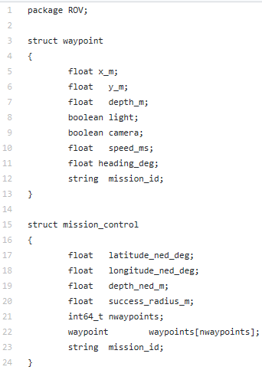
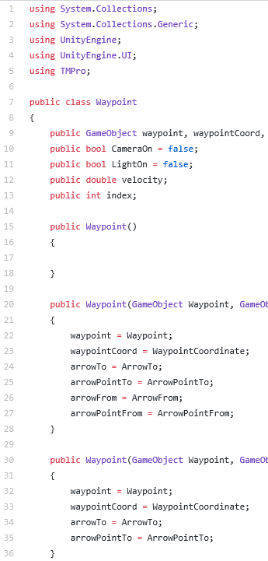
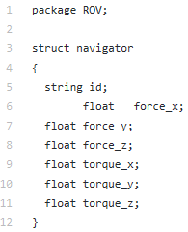
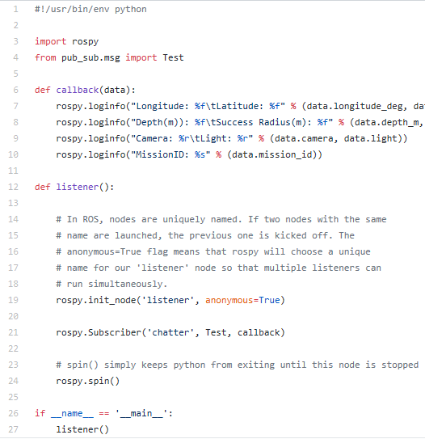
Code

Slide 13
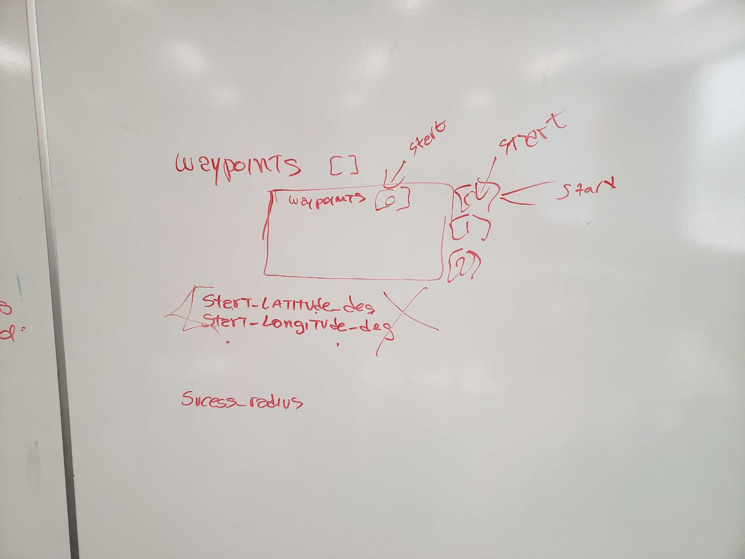
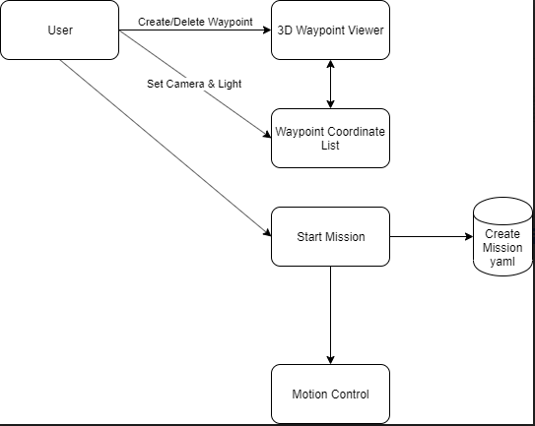
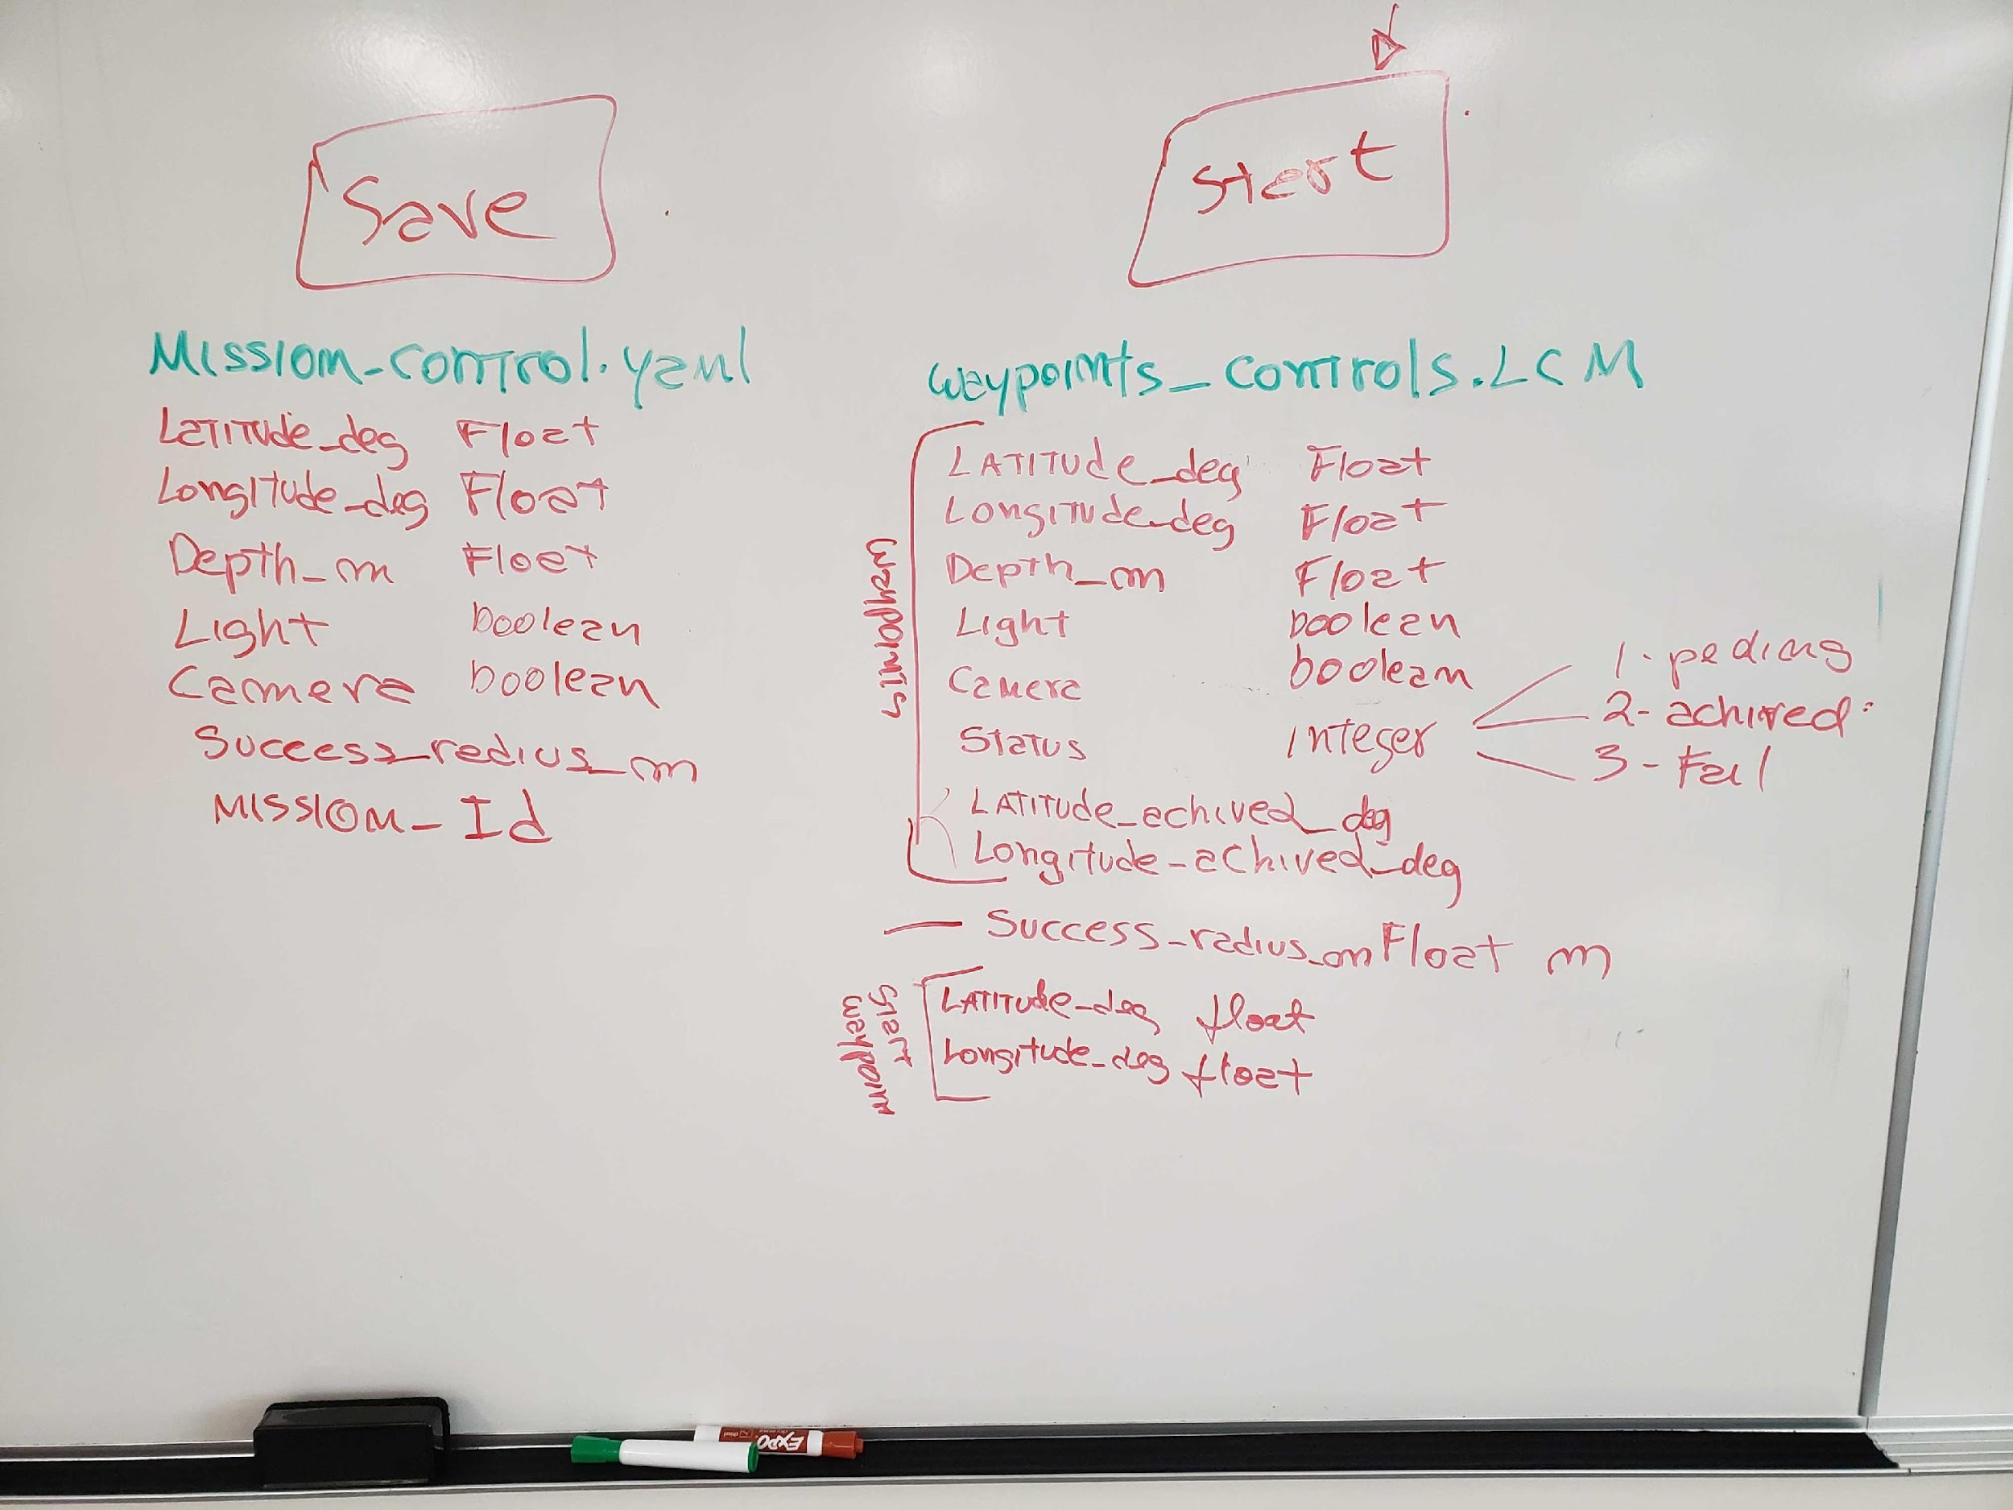
Diagrams

Slide 14
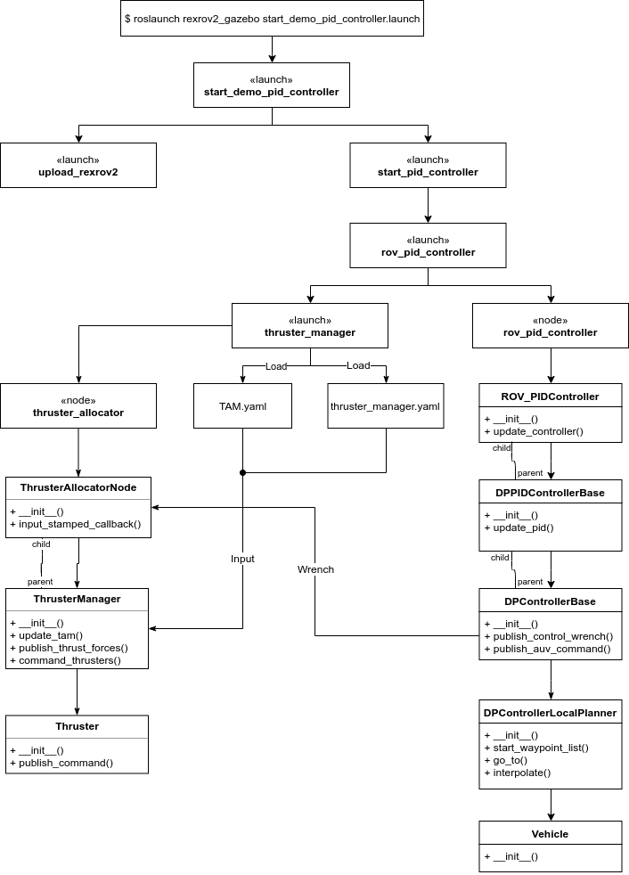
DIAGRAMS : SIMULATION REXROV2

Slide 15
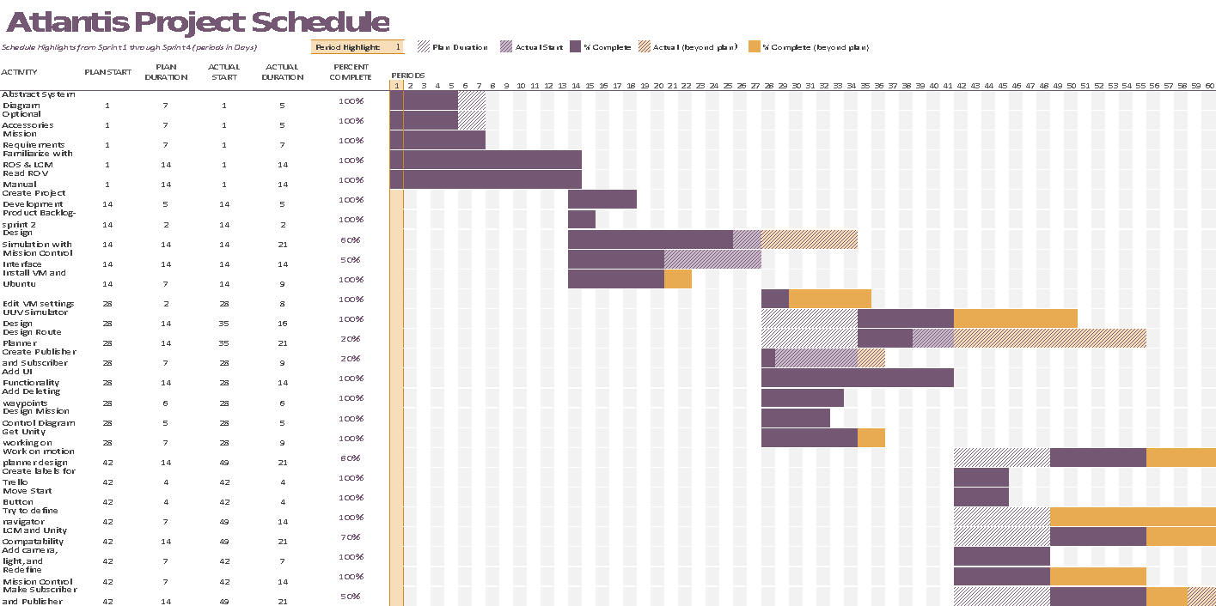
Project Schedule

Slide 16

TRELLO PROJECT TRACKING
Sprint Backlogs and Burndown Charts

Slide 17
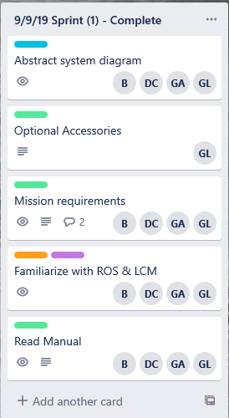
Trello : Sprint 1
Tasks
Burndown Chart

Slide 18
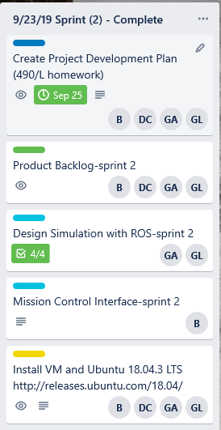
Trello : Sprint 2
Tasks
Burndown Chart

Slide 19
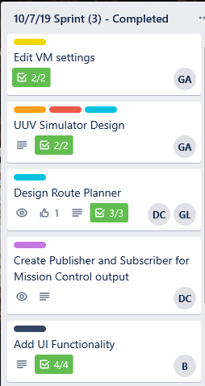
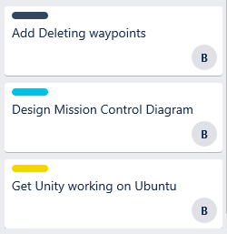
Trello : Sprint 3
Tasks
Burndown Chart

Slide 20
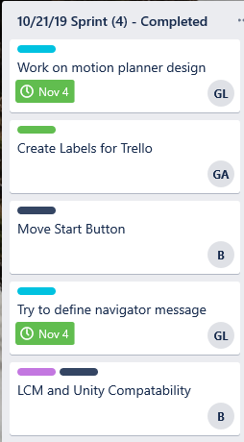
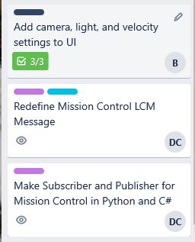
Trello : Sprint 4
Tasks
Burndown Chart

Slide 21
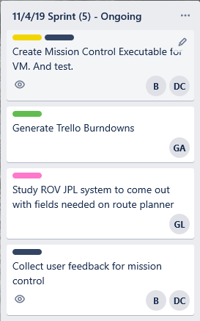
Trello : Sprint 5
Tasks
Burndown Chart

Slide 22
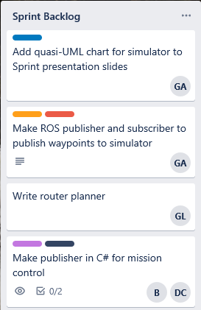
Trello : Sprint 6
Tasks
Burndown Chart

Slide 23

PROJECT ASSET LIBRARY
Hosted on Google Drive
Link: https://drive.google.com/drive/folders/1D58s5rOhGbV4GcWEc2uUwAG5J9ozqpOS

Slide 24
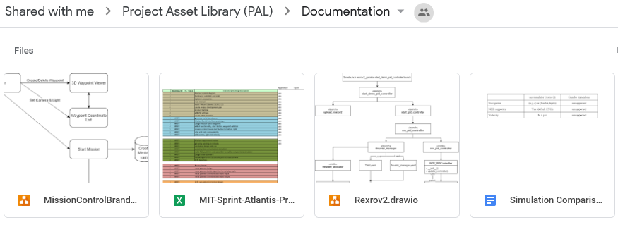
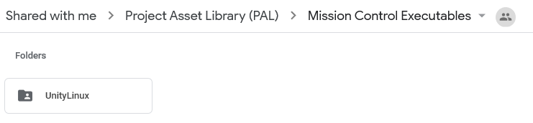
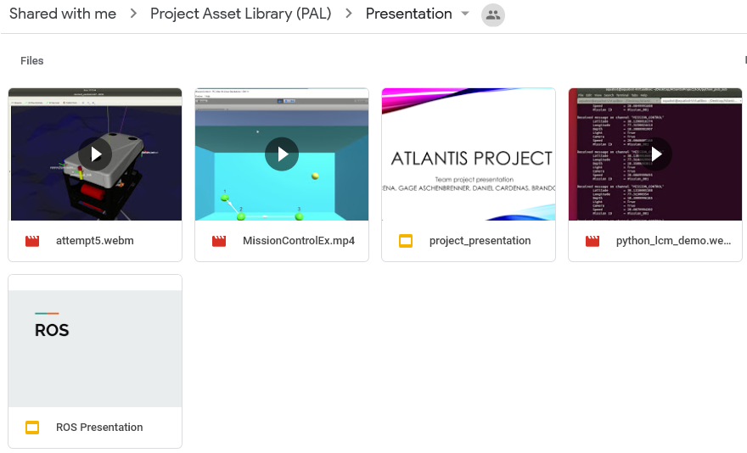
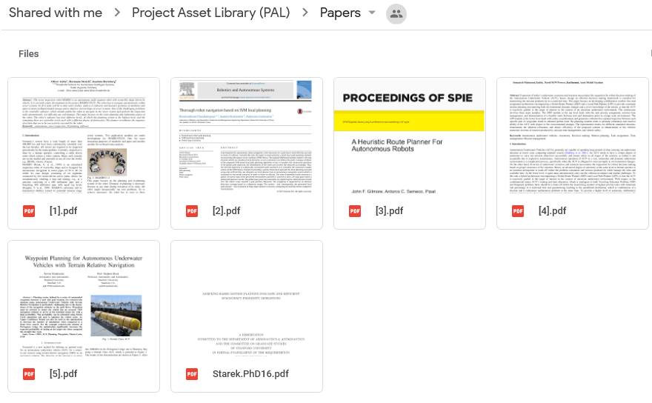
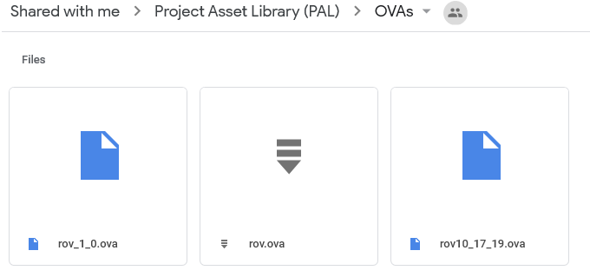
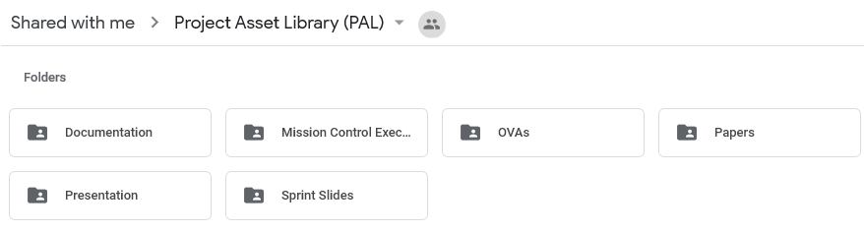
Project Asset Library (PAL)

Slide 25



Project Process Retrospective
What worked well?
What didn’t work well?
Changes to make for next semester?
Issues encountered?
Robust Simulator
UI runs intuitively
Learning experience
Simulator difficult to work with due to complexity
Unfamiliarity with simulator since it is not the same as used by JPL
Time consuming to figure out how to communicate with simulator
Dedicate more time to the project
Switch roles for members based on their strengths and weaknesses
More in-person interaction
Not enough people
High learning curve for members not familiar with certain aspects of Remote Operated Vehicles
The Virtual Machine has hardware limitations
Poor communication between members regarding high level design and components

Slide 26
PRODUCT DEMONSTRATION
Simulator finding waypoint

Slide 27
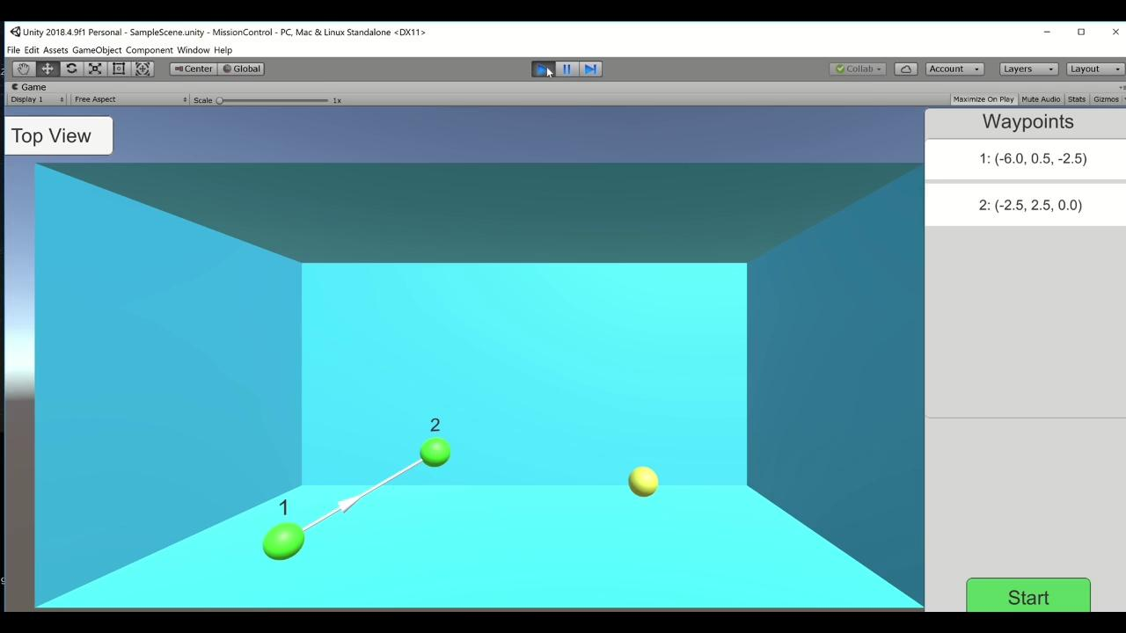
Simulator Demonstration

